Slide 1
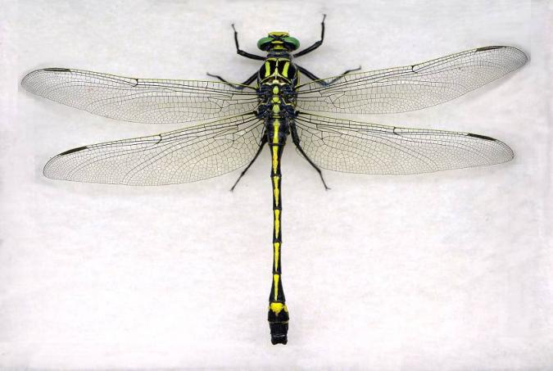
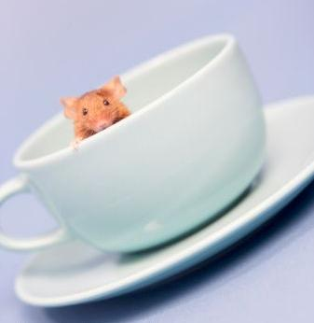

Preventative Pest Management
Pest Management in Practice
Dawn H. Gouge
University of Arizona
Notes:
1

Slide 2
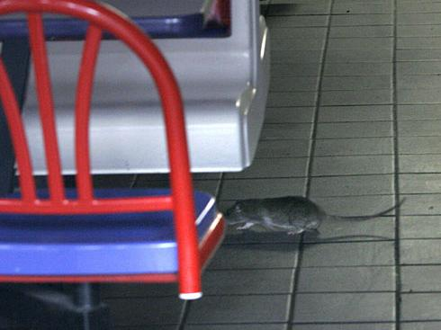

Slide 3
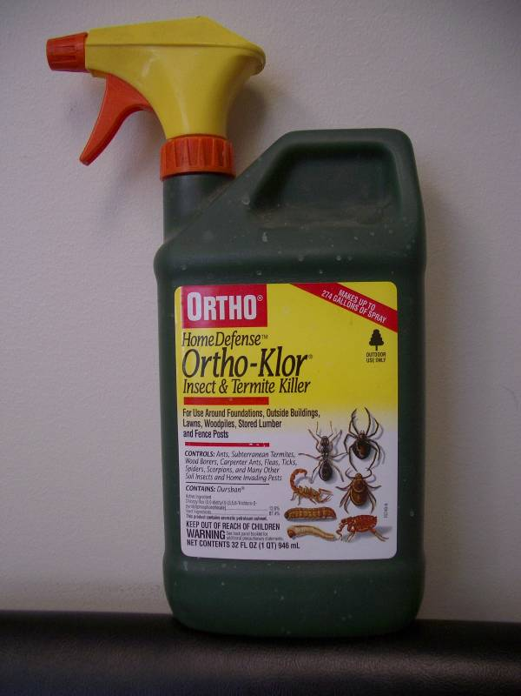


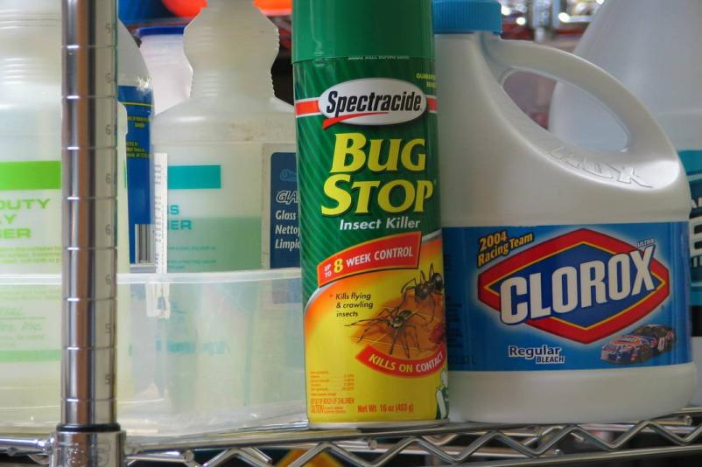
MAKES UP TO
274 GALLONS OF SPRAY
For Use Around Foundations, Outside Buildings, Lawns, Woodpiles, Stored Lumber
and Fence Posts
OUTDOOR
USE ONLY
Notes:
3

Slide 4
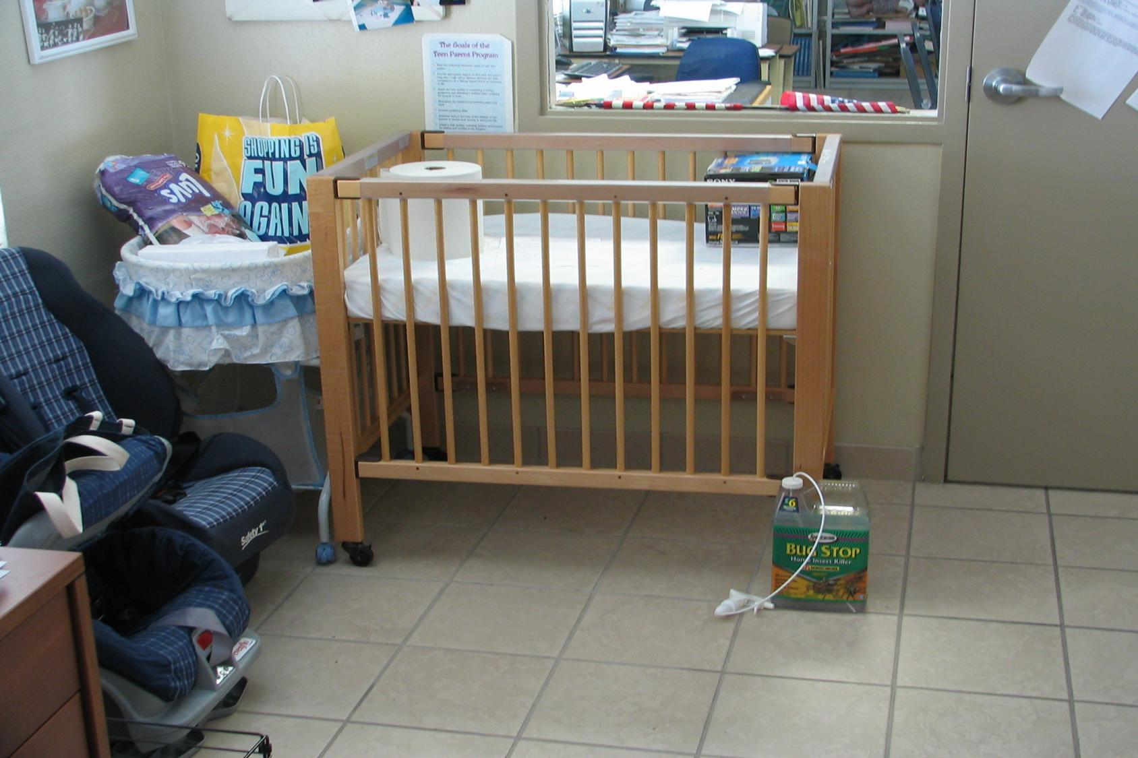
Notes:
4

Slide 5
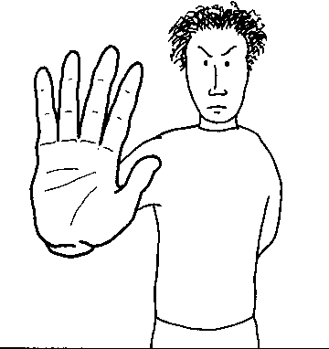
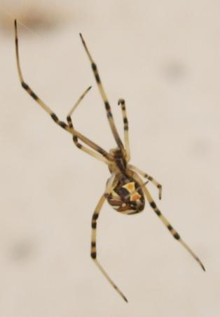
Pesticides KILL Pests They
DO NOT Prevent Pests
Management of the Learning
Environment
DOES
Prevent
Pests

Slide 6
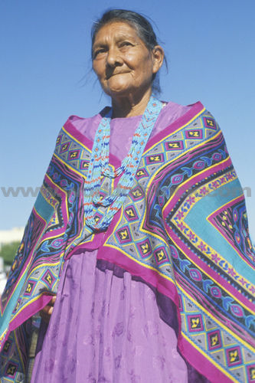
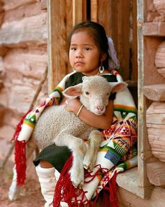
Pests of Concern
German cockroaches
House flies
House mouse
Mosquitoes

Slide 7
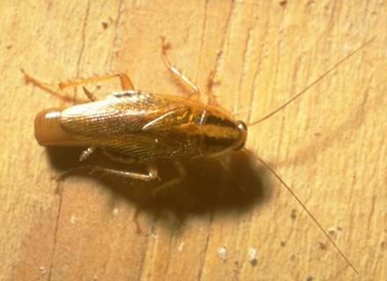
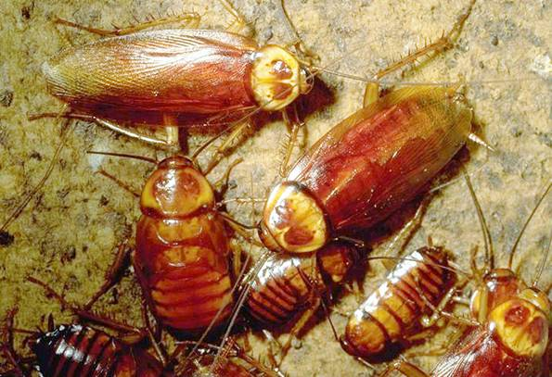
Cockroaches are all different
German
American
Notes:
7
Several good housekeeping procedures help to reduce cockroach incidents in homes: Clean house regularly, remove pet foods from the floor at night, eliminate water sources and seal cracks around base boards.
Don’t give them anything to eat, they will go somewhere else to dine.

Slide 8
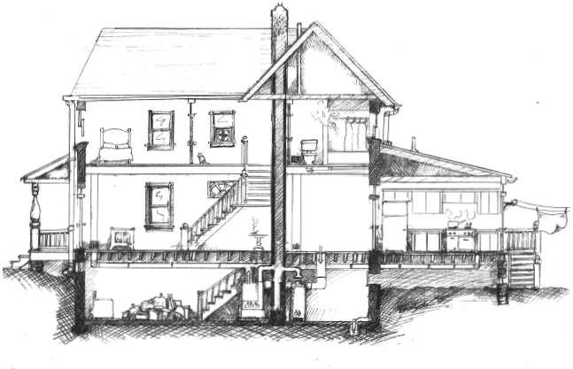
Think like a cockroach
Notes:
8

Slide 9
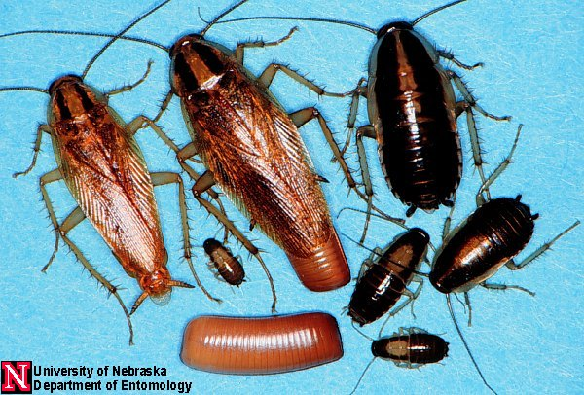
  German cockroach
  Like it warm and wet

Slide 10
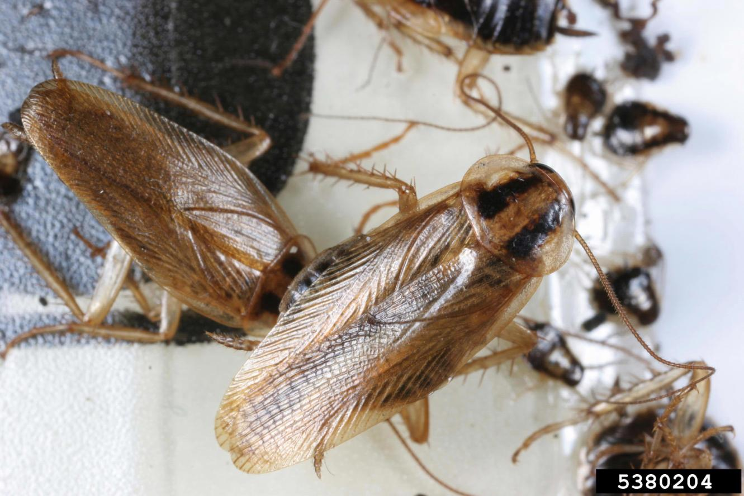
German cockroach - Indoor

Slide 11
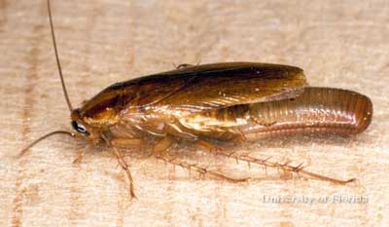
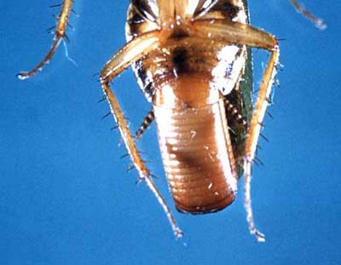
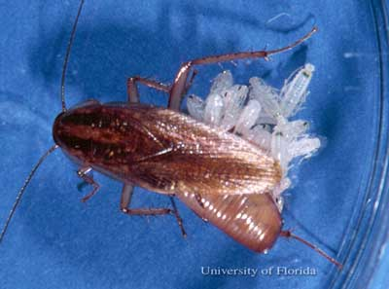
  German cockroach
    Like warm, humid places
    Proliferate in human homes
    Hide out in cracks and crevices close to food and water sources
German cockroaches
like hot/humid environments
Notes:
11

Slide 12
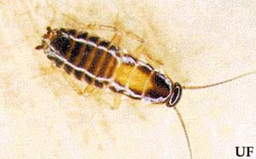
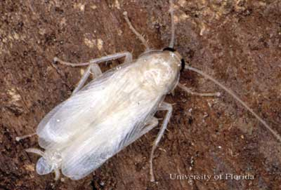
Egg case contains 30 to 40 eggs
Have elastic oothecae
Notes:
12

Slide 13
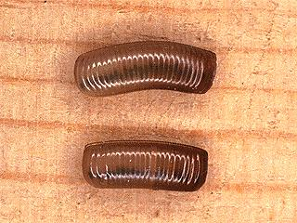
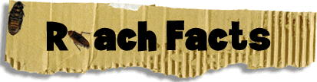
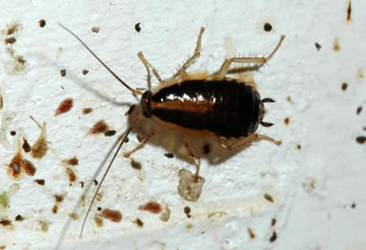
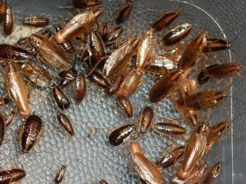
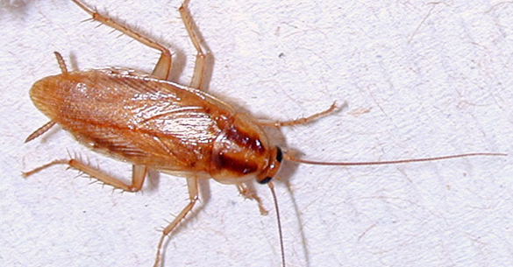
German cockroaches produce asthmagen compounds and allergen asthma triggers

Slide 14
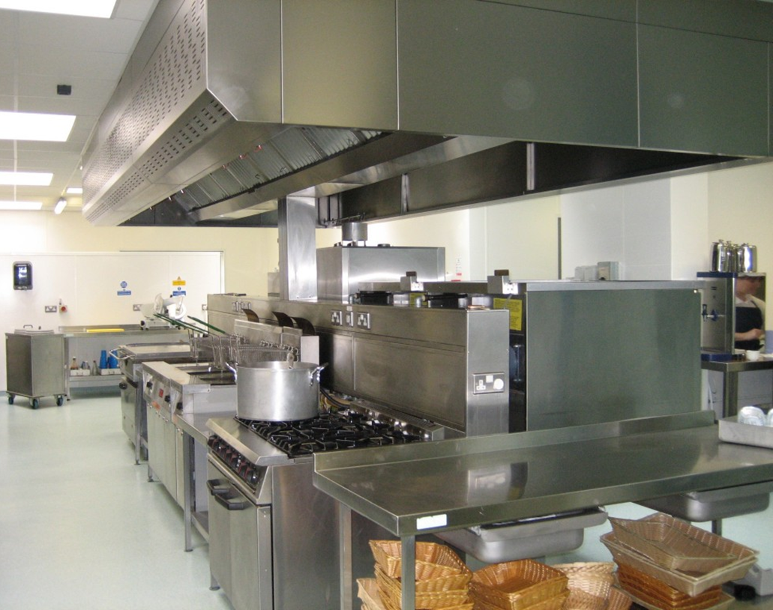
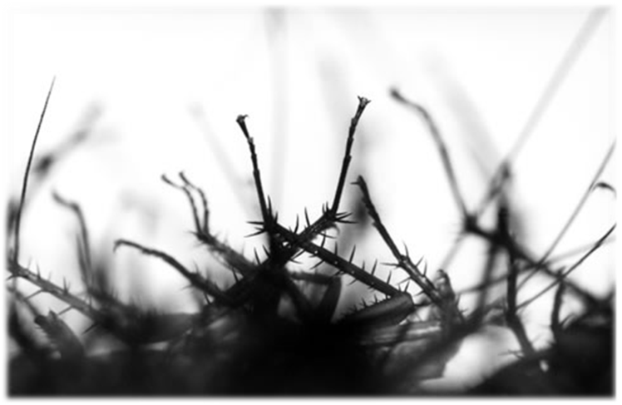
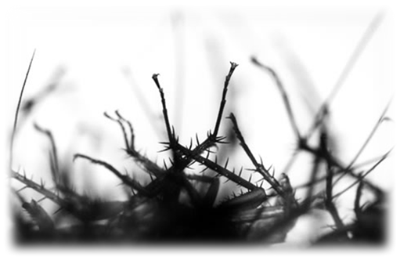
Cockroaches carry disease organisms, but have not been associated with major disease outbreaks in the U.S.
Notes:
Mozzies vector disease-causing viruses and parasites.
Viral diseases yellow fever, dengue fever and Chikungunya, Aedes aegypti
malaria Anopheles.
Mosquitoes are estimated to transmit disease to more than 700 million people annually in Africa, South America, Central America, Mexico, Russia and much of Asia with millions of resulting deaths. 2 million people annually die of these diseases.
Since most such diseases are carried by "elderly" females.
WNV About one in 150 people infected with WNV will develop severe illness severe symptoms can include high fever, headache, neck stiffness, stupor, disorientation, coma, tremors, convulsions, muscle weakness, vision loss, numbness and paralysis. These symptoms may last several weeks, and neurological effects may be permanent.
20 percent of the people who become infected have symptoms such as fever, headache, and body aches, nausea, vomiting, and sometimes swollen lymph glands or a skin rash on the chest, stomach and back. Symptoms can last for as short as a few days, though even healthy people have become sick for several weeks.
Approximately 80 percent of people (about 4 out of 5) who are infected with WNV will not show any symptoms at all.
Culex
2005 – 3000 deaths
1010 - <1000 deaths
Rats 10,000 bites per year in the US, most children less than 5 years old
Streptobacillus moniliformis (rat-bite fever). Hanta Virus, Lyme disease.
Histoplasmosis is a fungal disease, which grows in pigeon and bat droppings and soil. Symptoms of histoplasmosis appear about 10 days after initial infection and include fatigue, fever, and chest pains. Most people, however, do not show any symptoms. Those with compromised immune systems such as cancer patients or people living with HIV/AIDS are generally more at risk of developing histoplasmosis.
Cryptococcosis is a fungal disease associated with pigeon and bat droppings and also grows in soils. Risk factor for infection is a compromised immune system. According to the US Centers for Disease Control (CDC), nearly 85 percent of cryptococcosis patients are HIV-positive.
Psittacosis (or parrot fever) is a rare bacterial disease that mainly affects parrots and parrot-like birds such as cockatiels, and parakeets, but may also affect other birds, such as pigeons. When bird droppings dry and become airborne people may inhale them and get sick. 10 days after exposure, fatigue, fever, headache, rash, chills, and sometimes pneumonia. 70% of infected people had contact with infected pet birds. Those at greatest risk include bird owners, pet shop employees, veterinarians, and people with compromised immune systems.
Rabies is a dangerous, fatal disease, but only about 5 percent of bats submitted for testing are infected with the rabies virus. Every year, approximately 30 people are exposed to rabid animals in Arizona. People who have exposures must receive vaccine and anti-rabies serum treatment to prevent infection.
The rabies virus is transmitted in the saliva of infected animals. People usually become infected with the virus by being bitten by an infected animal, but any contact with the saliva of an infected animal (alive or dead) can potentially lead to infection if the person has an opening in the skin or the saliva gets into their eyes, nose, or mouth.
You cannot get rabies from the blood, urine, or feces of a rabid animal, or from just touching or petting an animal.
The rabies virus attacks the nervous system (brain and spinal cord). The first symptoms of rabies are similar to a flu-like
illness—fever, headache, and general discomfort. Within days, the disease can progress to symptoms such as anxiety, confusion, agitation, abnormal behavior, delirium, and hallucinations. Once symptoms appear, the disease is almost always fatal. Therefore, any person who has been bitten, scratched, or somehow exposed to the saliva of a potentially rabid animal should see a physician as soon as possible for postexposure treatment.
How serious is rabies?
Rabies is an extremely painful and deadly disease. As mentioned above, if prompt and appropriate post-exposure treatment is not received, the disease is fatal. Each year rabies kills more than 55,000 people around the world. Deaths from rabies are rare in the United States because of the wide availability of rabies vaccine and rabies immune globulin.
After an average of 30 to 50 days (as short as 14 days or longer than a year) from exposure to a rabid animal, a person develops an illness that may include fever, sore throat, stiff muscles, headache, tiredness, restlessness, nausea, and itching or tingling at the site of the bite. As the disease progresses, a person may become agitated, with periods of calm. Fear of water caused by severe throat spasms when trying to drink may occur. Paralysis then starts in the legs and moves towards the head. Most people die from cardiac arrest or respiratory failure within a short period after onset of illness.
A typical vaccination series with the rabies immunoglobulin can cost anywhere from $2,000 to $7,000+ per person.

Slide 15
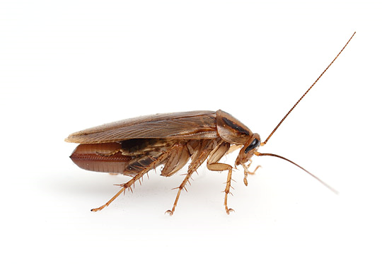
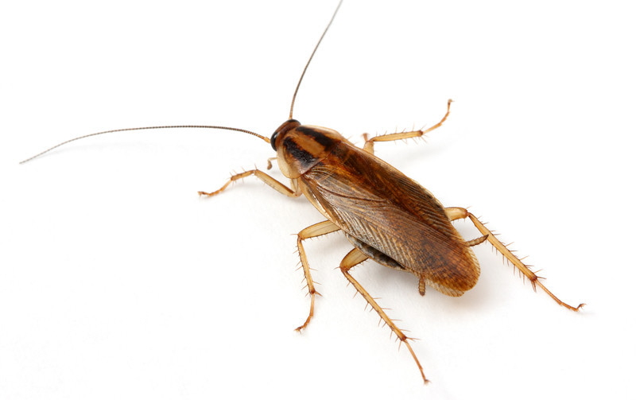
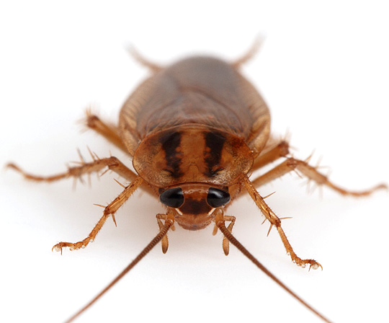
Prevention
Monitor, monitor, monitor!
Reduce cardboard
Keep clutter to a minimum
Maintain high sanitation standards
Corner clean
Drain clean
Keep food
enclosed
Notes:
15

Slide 16
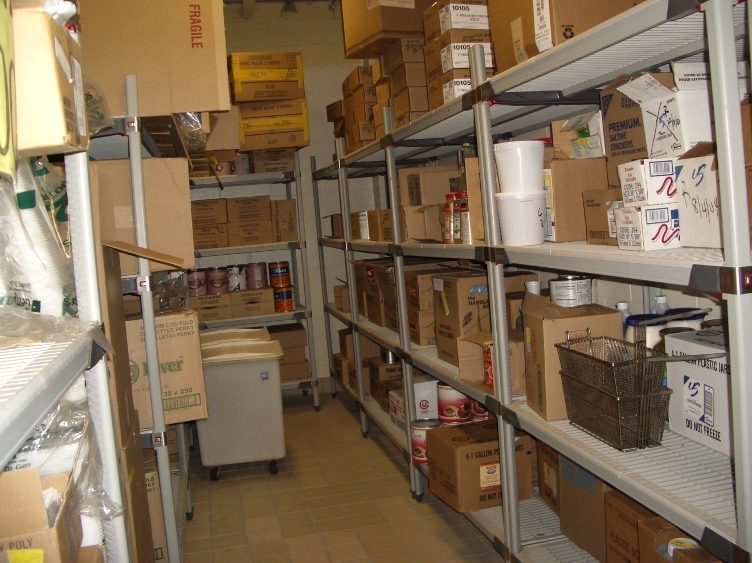
Cardboard cockroach condos

Slide 17
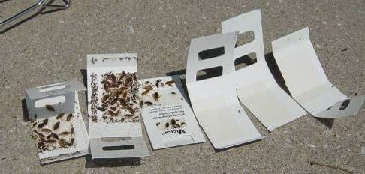
Know how to
read a trap

Slide 18
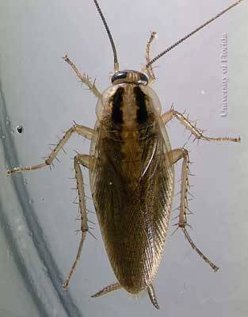
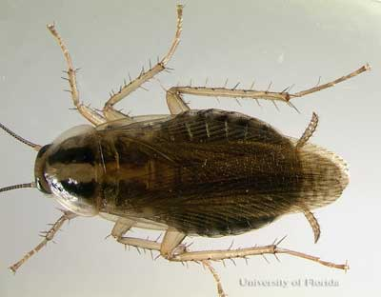
Male
Female
Actively growing populations are 80% nymphs and 20 % adults
Omnivorous: table scraps, pet food, book bindings, dead cockroaches
Notes:
18

Slide 19
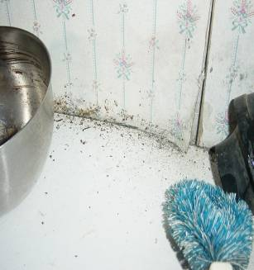
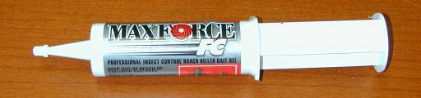
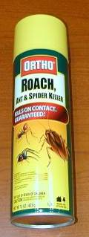
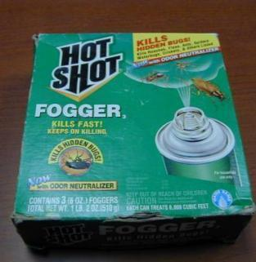
Good sanitation
Eliminate harborage
Bait
Will be effective if there
is no other food source
around
Notes:
19

Slide 20
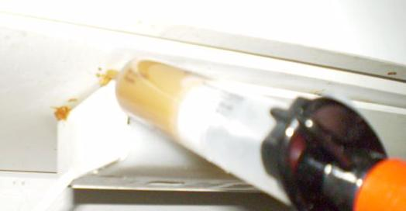
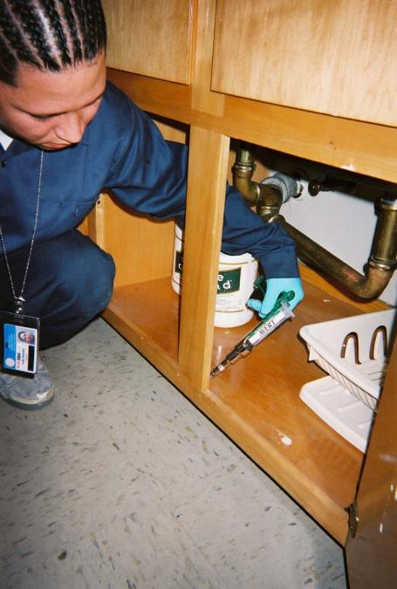
Kitchen Gel Placement
* Drawers: Alongside the interior of the door frame
* Cupboards: Underneath cupboards where frame meets wall
* Sink: Under counter
* Fume Hood: Along the inside rear corner of hood
Notes:
20

Slide 21
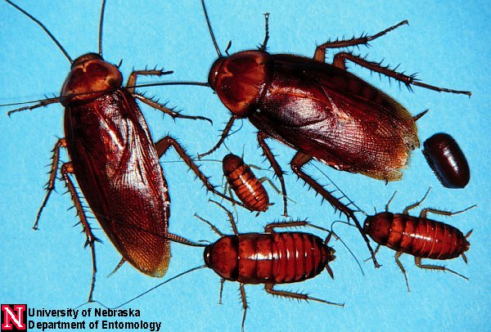
  American cockroach
  Periplaneta americana Like it warm and wet

Slide 22
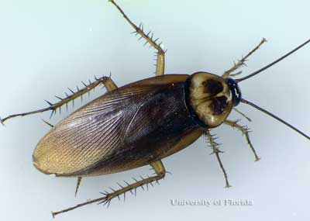
  American
  Outdoor cockroach
  Largest of the common peridomestic cockroaches - 4 cm in length
  During the day they respond negatively to light,
  resting in
  harborages close
  to water pipes,
  sinks, baths, and
  toilets, etc.
Notes:
22

Slide 23
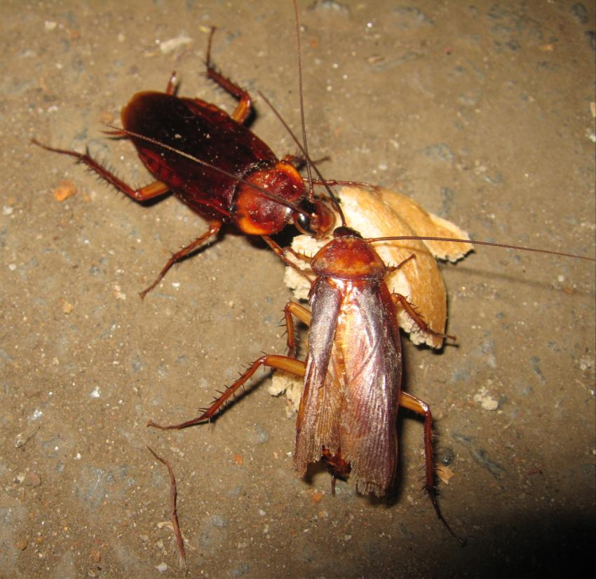
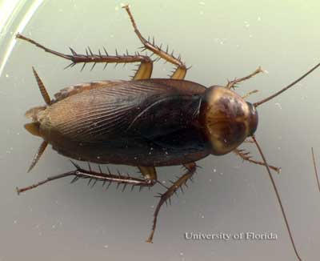

Slide 24
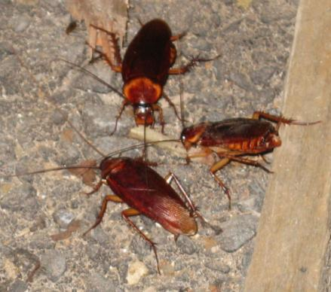
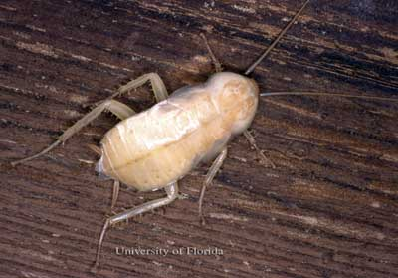
  Omnivorous and opportunistic feeders Consumes decaying organic matter
  Prefers sweets, but will eat paper, boots, hair, bread, fruit, book bindings, fish, peanuts, old rice, the soft part on the inside of animal hides, cloth and dead insects.
Notes:
24

Slide 25
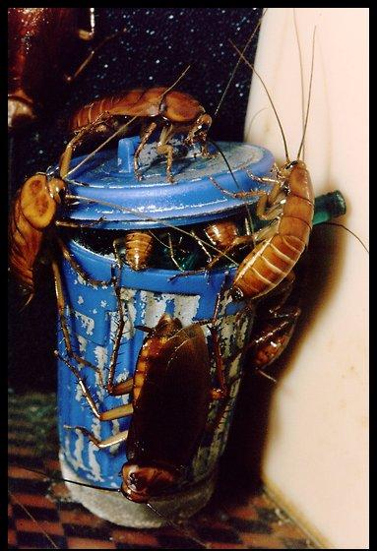
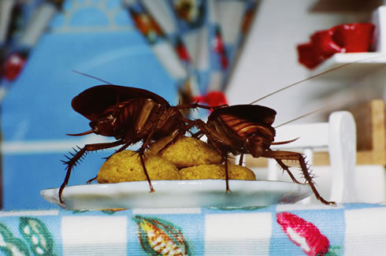
  Carry >22 species of pathogenic human bacteria,
  virus, fungi, and
  protozoans, as well
  as five helminthic
  worms
Notes:
25

Slide 26
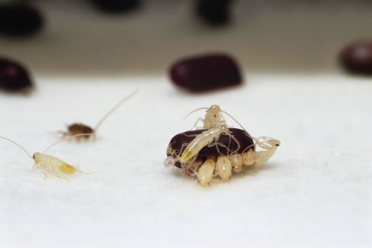

Slide 27


Presence of a single cockroach on a trap can
indicate a recent delivery with cockroaches in, or
an entry point, it also indicates IPM in practice
Notes:
Considering IPM philosophy, which statement is untrue?
Response
Pre test
Post test
Good waste management practices reduce opportunities for pests
Monitoring and inspection of pest vulnerable areas is particularly important
The presence of cockroaches in a glue trap is an indication that a food service establishment is not using IPM principles.
Pest prevention is everyone’s job.

Slide 28



Flies House flies
Each female fly can lay up to 500 eggs over three to four days
20 generations per year

Slide 29

House flies
A pair of flies beginning reproduction in April, under optimal conditions will generate 191,010,000,000,000,000,000 flies by August
191 quintillion,
10 quadrillion, etc….

Slide 30


Prevention
Keep doors closed, windows screened, door sweeps and weather-stripping intact.
Keep trash receptacles away from doorways
Bag trash
Keep dumpsters
clean and lids closed
Clean under non-slip
mats
Corner clean
Light-traps
Notes:
30

Slide 31
Waste management is pest
management

Slide 32




Slide 33




Calliphoridae
  Blow flies
  Arrive within minutes
Sarcophagidae
  Flesh flies
  Larviposit
  Migrate <30 ft as pre-pupae
Muscidae
  House flies
Notes:
Adult blow flies are generally 1/4 to 3/4 inches long and weigh less than an ounce. They reach their
sexual maturity in a few weeks and have a breeding season which stretches through the summer. The
female lays from 1,500 to 2,000 eggs which hatch in a little over a day. These larvae eat anything
which is rotting or have dead cells. They remain larva for just under 2 weeks and their pupal stage
is around a week before they become flies. The blow fly has a lifespan of 14 days to 8 weeks and
produces 4 to 8 generations per year.
They will soon burrow into the ground or some other
safe, dry place.....develop a cocoon type outer enclosure and remain there until they emerge in
a week to spend the remainder of their short life as a blow fly.

Slide 34


Dumpsters

Slide 35


House Mouse
  Poop
  Gnawing
  Rub marks
  Hair
  Nests/caches
  Tracks
  Sightings
  Sounds

Slide 36

House Mouse
  Food: cereal grains preferred, but most types of edible materials; a nibbler - daily requirement - 1/10th ounce.
  Can utilize metabolic water in food to survive.

Slide 37

General rodent facts
Poor vision, color blind
Keen smell, taste, touch, hearing
Mostly active evening, early morning
Omnivores
Hoarders
Territorial
Do not go beyond home range easily
Provision nest with any soft material
Reproductively prolific; may be pregnant while nursing pups
Kinesthetic memory, orient via touch

Slide 38

Signs

Slide 39



Prevention
Eliminate entryways
Reduce clutter
Monitor for signs
Keep dumpsters
clean and lids closed
Maintain good
sanitation standards
Maintain a clear/
open perimeter around
buildings
Notes:
39

Slide 40


Evidence of
Clutter Bugs

Slide 41


Slide 42


Slide 43


Corner
clean
Notes:
Vents and air doors
Lights over door
Thresholds and poorly maintained weather stripping at the side of doors

Slide 44



Slide 45



Slide 46


Slide 47





Slide 48

All you can eat buffet for rodents

Slide 49


Slide 50





Mosquitos
Notes:
Anopheles freeborni, Culex quinquefasciatus,
Psorophora columbiae, Aedes aegypti, Culex tarsalis.

Slide 51





Notes:
Estimates of adult mosquito populations are made by counting the number of adults landing on the surveyors legs over a period of time. Larval counts can be made by sampling measured scoops from water reservoirs. Body counts of adults and larval counts in scoops can sometimes result in a TMTC result (Too Many To Count).

Slide 52








¼ inch of water
Notes:
Estimates of adult mosquito populations are made by counting the number of adults landing on the surveyors legs over a period of time. Larval counts can be made by sampling measured scoops from water reservoirs. Body counts of adults and larval counts in scoops can sometimes result in a TMTC result (Too Many To Count).

Slide 53



Flooded School Play
Field
Notes:
Enabling pests

Slide 54

Sufficient water to produce thousands of mosquitoes

Slide 55


WNV

Slide 56





Slide 57
Prevention
Flower pots and other containers
Flush out the water in bird-baths and fountains
Store boats, canoes and other objects so that they do not collect rainwater
Remove water that collects in depressions in tarpaulins
Keep rain gutters free of leaves and other debris

Slide 58
Prevention
Correct drainage problems
Fill holes or depressions in trees with sand or mortar
Repair leaky pipes and outside faucets, and connect open waste-water drains to a sewage system
Empty water containers for pets and livestock
Correct or report drainage problems in ditches along roadways

Slide 59
West Nile Chikungunya
Virus
1^{O} vectors
Human hosts
% symptomatic
% chronic
% fatality
Flavivirus
Culex
Incidental
>20%
>1%
>1%
Alphavirus
Aedes
1^{O} host
72-97%
30–40%
0.03%

Slide 60

IPM
Improving sanitation
Eliminate pest conducive conditions (habitat manipulation)
Monitor – monitor - monitor
Select your treatment
tools carefully
Pest exclusion
Educate,
communicate,
build partnerships
Judicious use of pesticides
Notes:
The essential components of a community IPM program are best listed as follows (select the most accurate answer):
Response
Pre test
Post test
Educate homeowners to protect themselves from pesticides, use the safest pesticide available, monitor pesticide effectiveness, and modify pesticide application program when needed.
Application of multiple treatment options every 4 months in homes, every 3 months in food service establishments, and every 2 months in schools.
Avoidance of chemical pesticides, pest exclusion, education and communication on pests and IPM practices, and working with local policy-makers to enact regulations and ordinances for pest control.
Elimination of pest conducive conditions, ongoing monitoring and inspections, judicious use of pesticides when necessary, pest exclusion, education and communication on IPM practices, building partnerships focused on best practices

Slide 61



Pest-proofing

Slide 62


Slide 63



Prioritize entrance points to PVAs

Slide 64


Keep
doors
shut
Notes:
Vents and air doors
Lights over door
Thresholds and poorly maintained weather stripping at the side of doors

Slide 65


Keep them out:
Excluding (pest proofing) pests using barriers, including screens, seals, nets and high quality fillers

Slide 66

Ask questions

